Slide 1

SkillCourt 5 Name:
Gajenthiran Gunasegaram
Team Member(s): Sean Borland Product Owner(s):
Gudmundur Orn Traustason
Instructor: Masoud Sadjadi School of Computing and Information Sciences Florida International University
Senior Project Final Presentation
<Summer 2016>
August 5, 2016
Notes:
7 seconds.
Greet your audience, thank them for attending your presentation, introduce yourself, introduce your project, introduce your team members, and quickly indicate what each of you did in a high-level manner, and put more emphasis on your part/contribution.
I have asked the photographer to take a photo of you when you are presenting this page (I will share your photos with you one week after showcase). be relaxed and smile and please don’t look at the camera.

Slide 2
Project definition
Notes:
10 seconds.
Introduce the problem that the whole project (in all versions) tackles with GIF or screenshot.

Slide 3
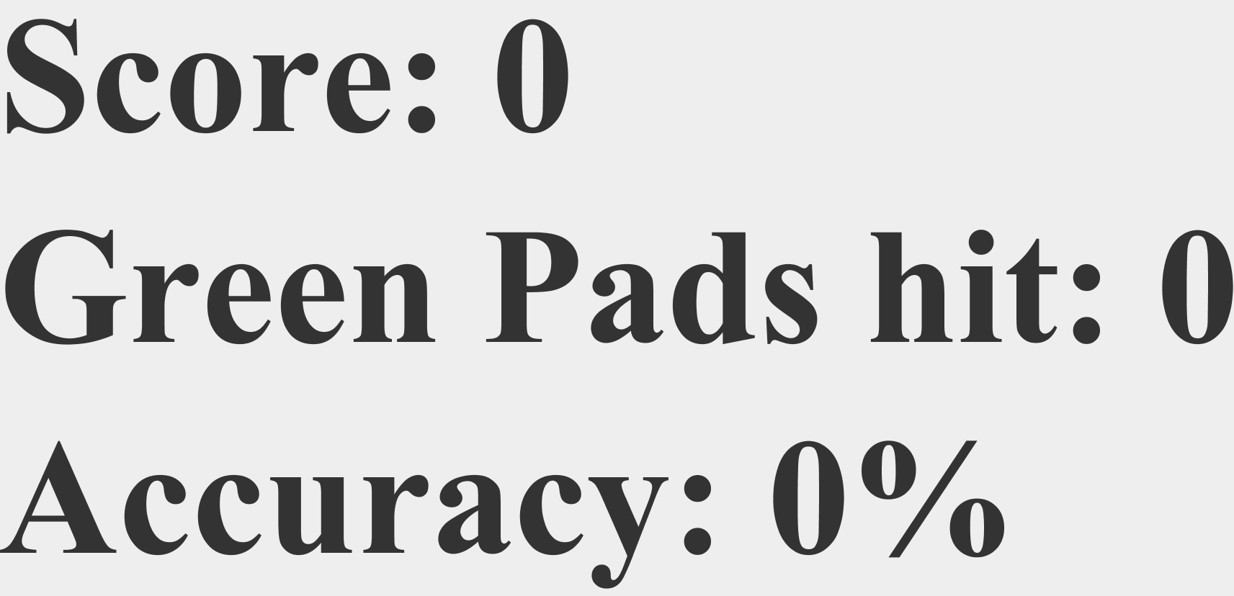
Project definition
Notes:
20 seconds.
Introduce the problem that the your project (in new version) tackles with GIF or screenshot.

Slide 4
Requirements: Use Cases
Notes:
5 seconds
Show the Use Case Diagram for the whole project. Highlight your use cases.

Slide 5
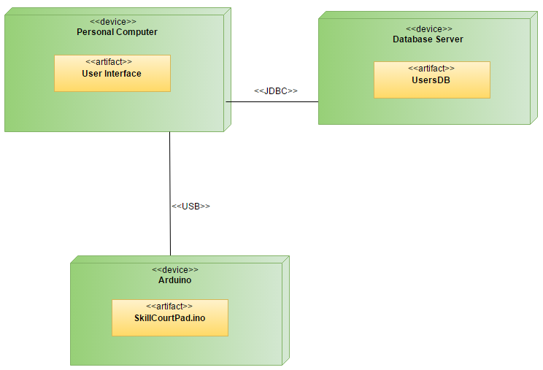
System Design: Architecture
Notes:
20 seconds
System design: Highlight the parts that you contributed to them.
1. System decomposition; identify the architecture patterns used
2. System deployment – h/w and s/w requirements

Slide 6
Minimal Class Diagram
Notes:
10 seconds.
Minimal class diagram. Highlight the classes that you created/modified
Identify the design patterns used (one or more slides).

Slide 7
User Stories
1. Connect and send a sequence to multiple pads
2. Send discrete sequences to each pad
3. Provide instant feedback
4. Create and manage database
5. Provide final results with score viewing/uploading
Notes:
5 seconds.
List the user stories that you worked on them.(put in order of importance). Stay focused on the parts that you have been working.

Slide 8
User Story #1: Connect and send a sequence to multiple pads
Most important user story, because it starts off the implementations of our own new ideas for the new system.
Important tasks
Learning the Arduino/Java relationship
Communicating with the Serial Port using the Java RXTX library
Establish connection with Arduino
Send method to change color on Arduino LED
Notes:
60 seconds
The tile of user story
The most important user story you worked on it. You have to describe this one very well and be proud of that.
Please present and show the complexity of your work, code, algorithms, and technical challenges and technologies you have used. (you could use screenshot if you want. Visual presentations are better than text presentation)
Go into the details of the most important/significant tasks using bullet lists or visual graphs or state chart diagram
Sequence Diagram for this user story is mandatory (in another separate page if required)
Demo using screenshots or GIF (in another separate page if required)

Slide 9
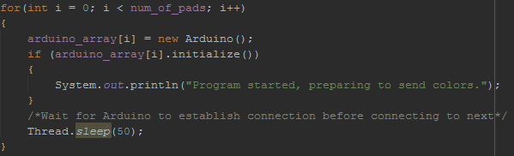
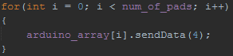
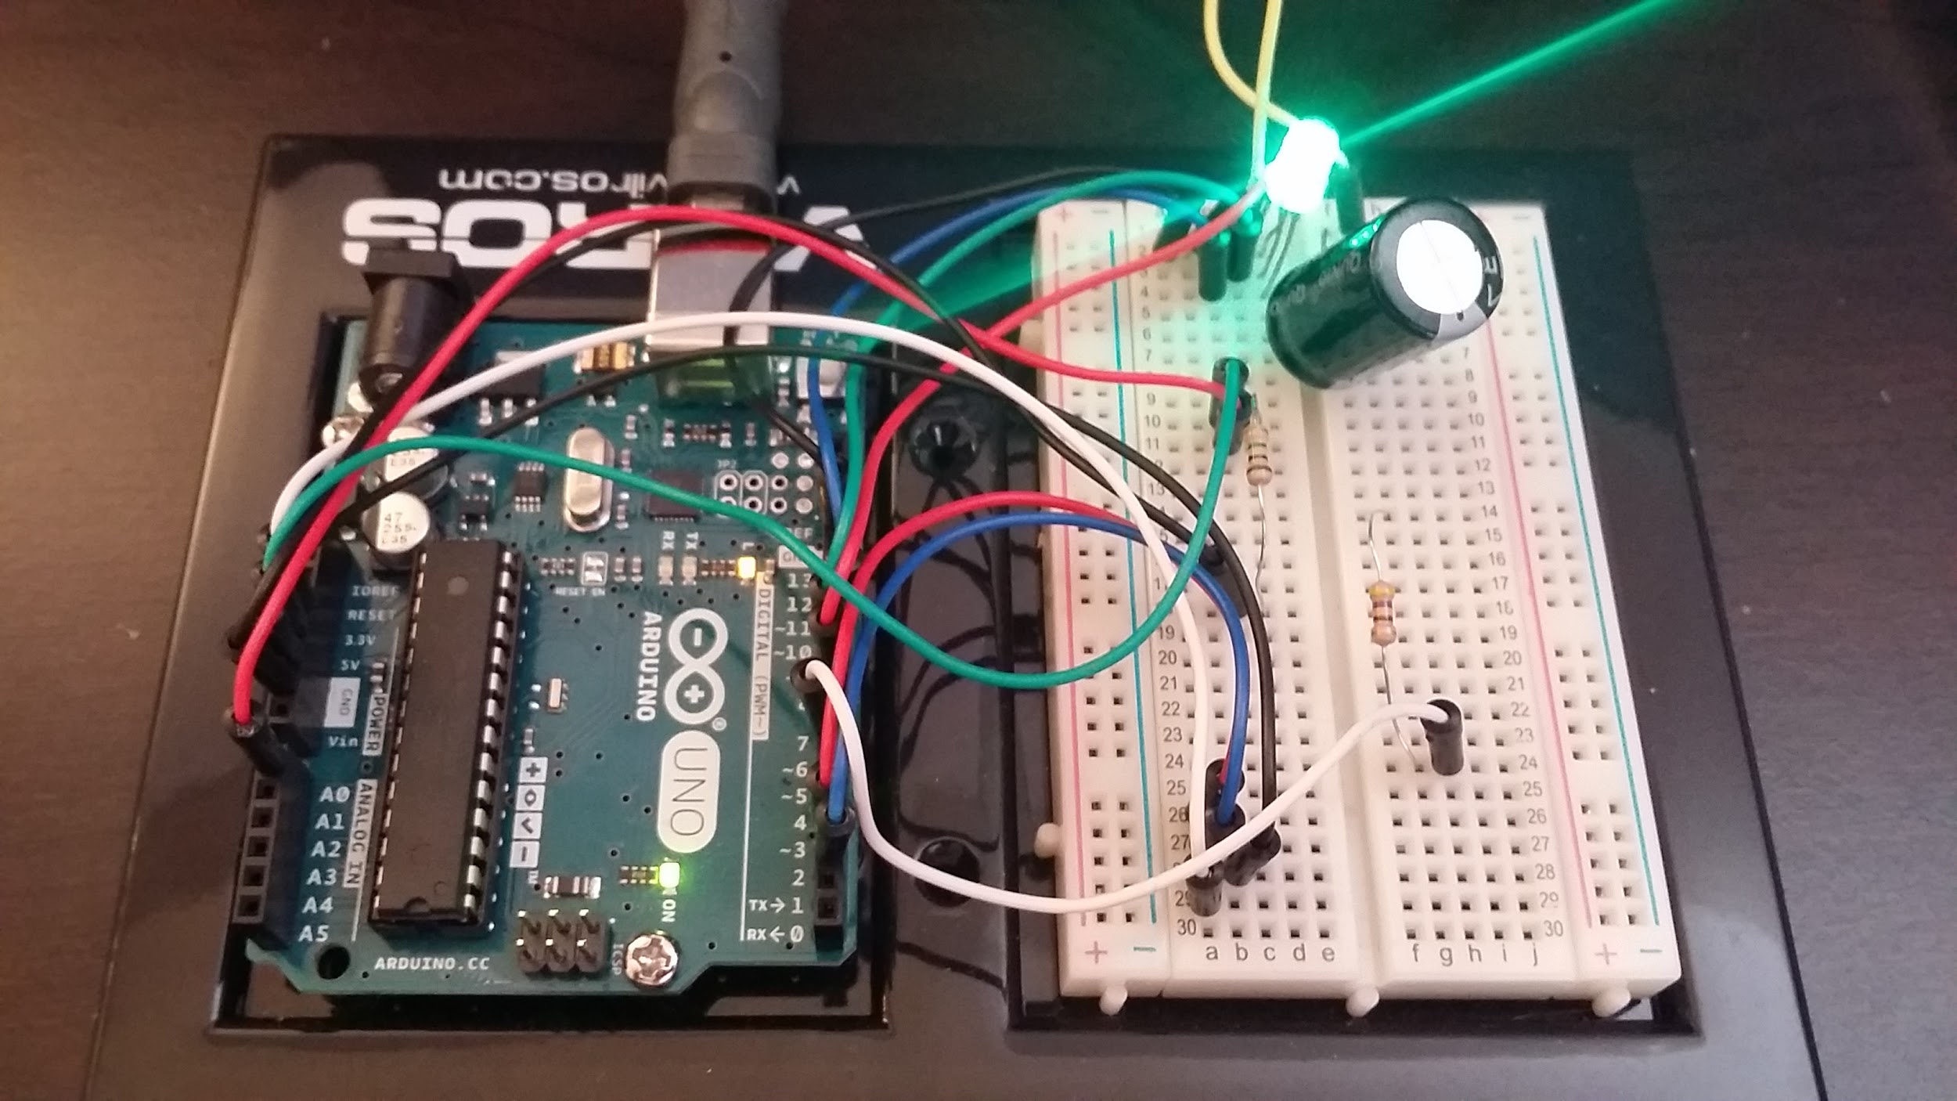
User Story #1: Code Examples/Demo

Slide 10
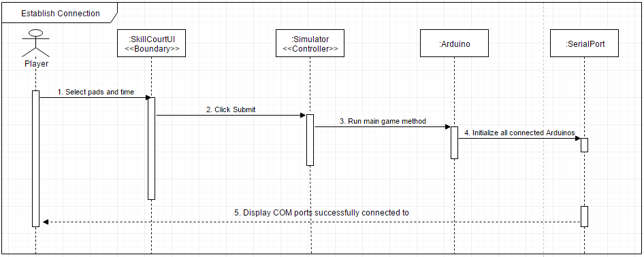
User Story #1: Sequence Diagram

Slide 11
User Story #2: Send discrete sequences to each pad
Next user story to build on first. Main goal was to get individual sequences to each pad, in previous user story, all pads saw same sequence.
Important tasks
Finding a way to cycle communication to each pad
Sending different data to each pad
Prevent outlier situations
Notes:
20 seconds
The tile of user story
Please present and show the complexity of your work, code, algorithms, and technical challenges and technologies you have used. (you could use screenshot if you want. Visual presentations are better than text presentation) - Go into the details of the most important/significant tasks using bullet lists or visual graphs or state chart diagram - Demo using screenshots or GIF (in another separate page if required)
Sequence Diagram for this user story is optional

Slide 12
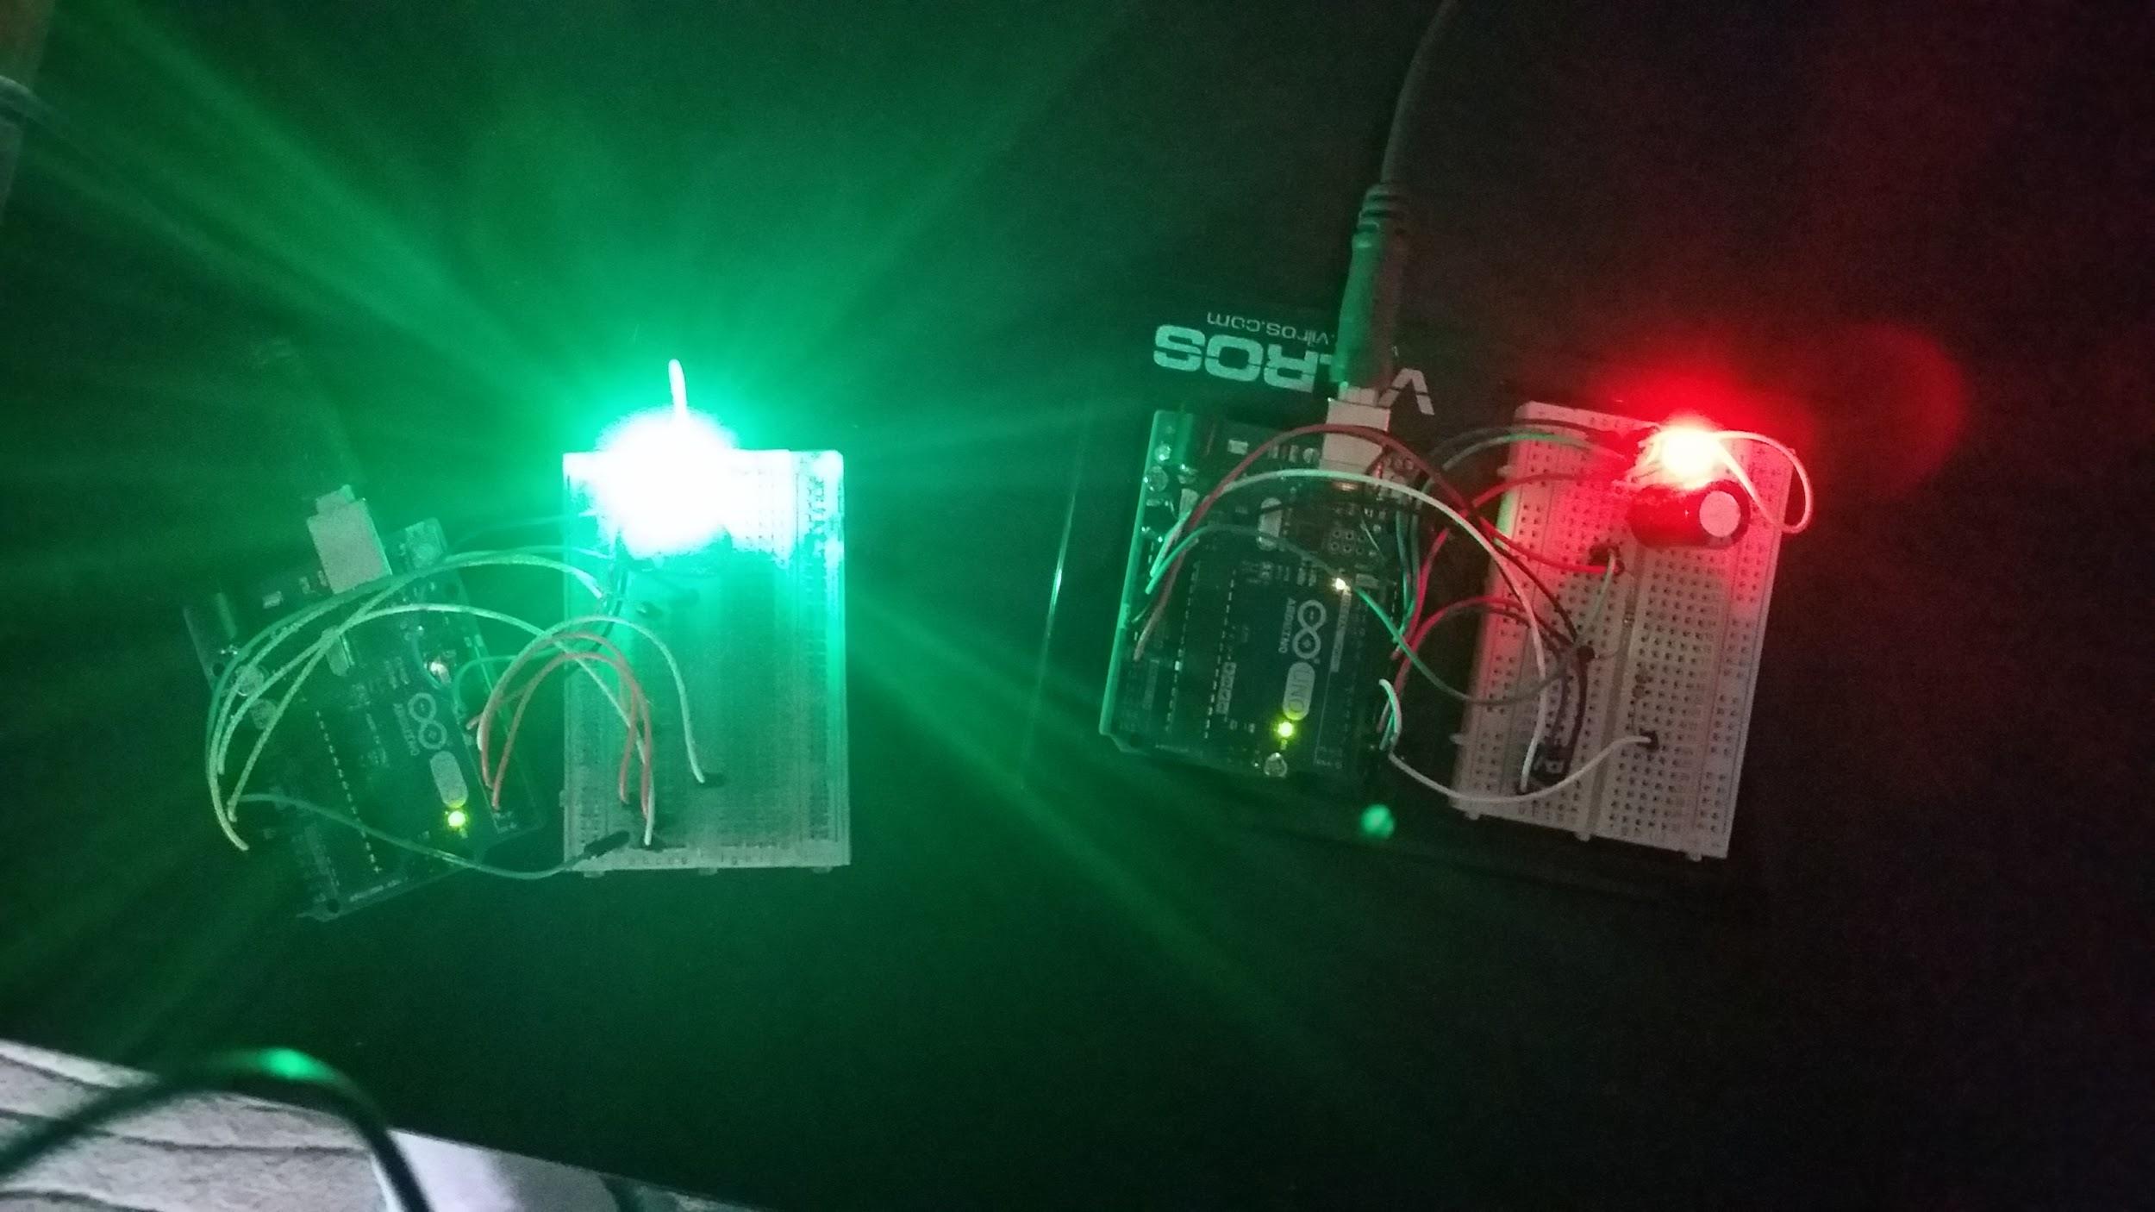
User Story #2: Demo

Slide 13
User Story #3: Provide instant feedback
Important user story for PO, one of the main things he wanted for this iteration of the project. Implemented after core system was built using new system
Important tasks
Create statistics to measure from each player
Create a scoreboard to display stats
Thread the scoring method to run in background
Update and display scores as player hits pads.
Notes:
20 seconds
The tile of user story
Please present and show the complexity of your work, code, algorithms, and technical challenges and technologies you have used. (you could use screenshot if you want. Visual presentations are better than text presentation) - Go into the details of the most important/significant tasks using bullet lists or visual graphs or state chart diagram - Demo using screenshots or GIF (in another separate page if required)
Sequence Diagram for this user story is optional

Slide 14
User Story #3: Demo

Slide 15
User Story #4: Create and Manage Database
User story for implementing database functionality for user accounts.
Important tasks
Implement SQL Database
Create Login functionality
Implement Create Account functionality
Create forgot password functionality
Notes:
20 seconds
The tile of user story
Please present and show the complexity of your work, code, algorithms, and technical challenges and technologies you have used. (you could use screenshot if you want. Visual presentations are better than text presentation) - Go into the details of the most important/significant tasks using bullet lists or visual graphs or state chart diagram - Demo using screenshots or GIF (in another separate page if required)
Sequence Diagram for this user story is optional

Slide 16
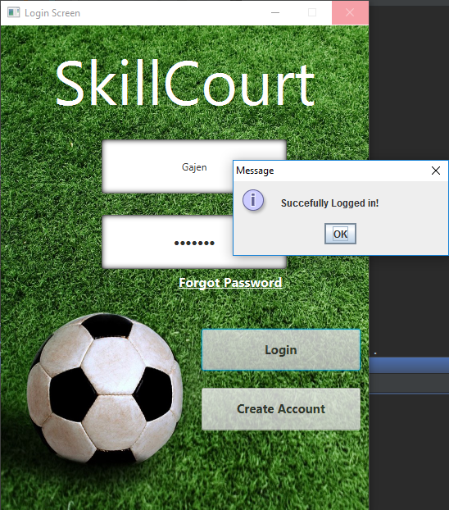
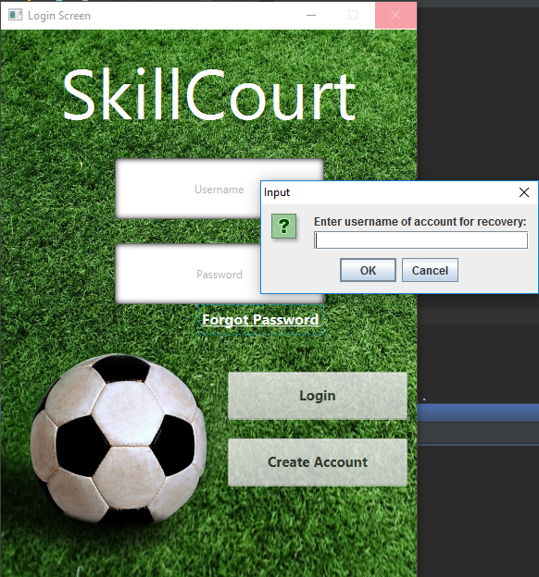
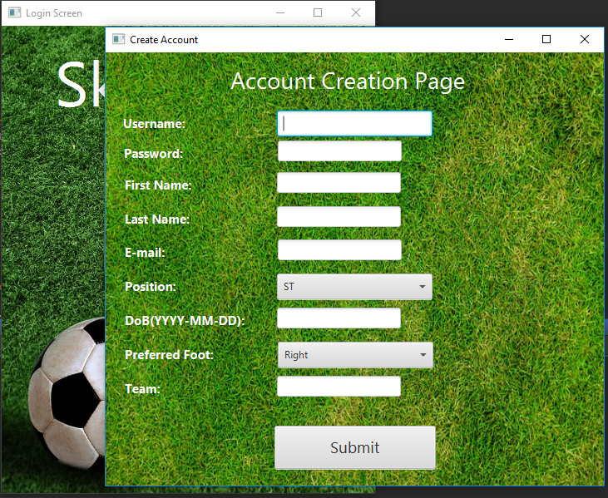
User Story #4: Demo

Slide 17
User Story #5: Provide final results with score viewing/uploading
User story for displaying a final results screen with more detailed statistics and options for viewing and uploading scores
Important tasks
Display final results to user
Create view previous score functionality
Create upload score functionality
Create play again functionality
Notes:
20 seconds
The tile of user story
Please present and show the complexity of your work, code, algorithms, and technical challenges and technologies you have used. (you could use screenshot if you want. Visual presentations are better than text presentation) - Go into the details of the most important/significant tasks using bullet lists or visual graphs or state chart diagram - Demo using screenshots or GIF (in another separate page if required)
Sequence Diagram for this user story is optional

Slide 18
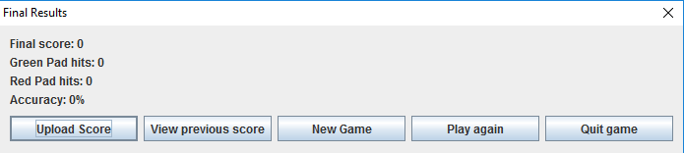
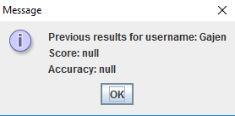
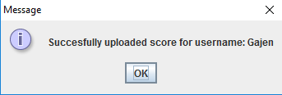
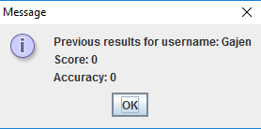
User Story #5: Demo

Slide 19
Test Suites and Test Cases
Sunny Day Test
Test Case ID: UC724_01
Test Purpose: To determine if multiple pads can be connected to with Arduino source code uploaded.
Test setup: 2 or more Arduinos connected to computer.
Arduino source code loaded into boards.
Arduino object instantiated in Java.
Test Output: Trying:
port COM3
port COM4
connected on port COM3
connected on port COM4
Expected output: Successfully connected to Arduinos.
Notes:
10 seconds
A description of verification process and Test Suites and Test Cases for one of the use cases.
1 One sunny day and one rainy day for the implemented use cases (one or more slides).
2 Automated test scripts for the implemented use cases (if any) (one or more slides).

Slide 20
Test Suites and Test Cases
Rainy Day Test
Test Case ID: UC724_02
Test Purpose: To determine if multiple pads can be connected to without any Arduino source code uploaded.
Test setup: 2 or more Arduinos connected to computer.
Arduino object instantiated in Java.
Test Output: Trying:
port COM3
port COM4
unable to connect to COM3: NullPointerException
unable to connect to COM4: NullPointerException
Expected output: A NullPointerException will be thrown from each of the COM ports that are hosting an Arduino board.

Slide 21






Summary
gguna002@fiu.edu
Questions?
Thank You!
Notes:
10 seconds
Summarize your contribution, mention your effort for Scrum, Mingle, Github, Google Drive Documentation and minutes
Include your contact information
Ask if anyone has any questions for you.
Thank your audience

